Slide 1

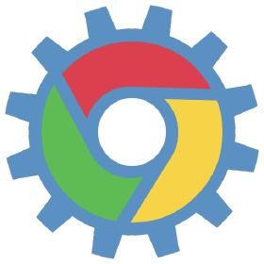
Boost your UI test automation with Chrome DevTools Protocol [JS and Python experience]

Slide 2
About me:
Viktor Hryhorchuk
Senior Test Automation
https://vvgrygorchuk.medium.com/
https://www.linkedin.com/in/victor-grygorchuk-532383141/

Slide 3
We are going to talk about:
A few words about Chrome DevTools Protocol (CDP).
CDP in Selenium tests: use cases.
Send a command to CDP from Selenium 3.
Other CDP clients.
Connecting to CDP on the local machine.
CDP access on the remote machine (Selenium Grid).
Adding Lighthouse performance tests to Selenium tests.

Slide 4
Chrome DevTools Protocol
JSON RPC protocol, which provides tools to instrument, inspect, debug and profile Chromium, Chrome and other Blink-based browsers.
https://chromedevtools.github.io/devtools-protocol/

Slide 5

Use cases: why do we need CDP in auto-tests?
This is Mursik, the tester
- Mursik wants to control network in the browser;
- Intercept API request, mock API response;
- Simulate network conditions;
- Check performance metrics.

Slide 6
New king is coming, Selenium 4!
Selenium 4 has a client to connect to CDP;
Selenium 4 doesn’t have a stable release yet.
https://www.selenium.dev/blog/2020/what-is-coming-in-selenium-4-new-tricks/

Slide 7
To tell the truth, even Selenium 3 knows how to send commands to Chrome DevTools Protocol.
driver.execute("executeCdpCommand", {cmd: cmd, params: args})
Cmd: string name of the CDP command
Params: command parameters. More here https://chromedevtools.github.io/devtools-protocol/

Slide 8
Network demo

Slide 9

Puppeteer - is a Node.js library to control Chromium based browser over Chrome DevTools protocol
It’s developed by mighty Google,
It knows all tricks from CDP,
It’s faster than Selenium.
https://github.com/puppeteer/puppeteer

Slide 10
Puppeteer Cons
It targets mostly Chromium, partly it has support for Firefox,
It’s implemented for Node.js only and has no any plans for other languages.
https://github.com/puppeteer/puppeteer

Slide 11
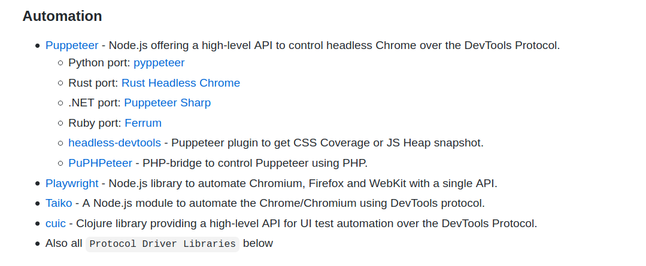
Other Open Source CDP Clients:
https://github.com/ChromeDevTools/awesome-chrome-devtools

Slide 12
Pyppeteer - unofficial Puppeteer port to Python.
Knows the same tricks as official Puppeteer;
Google doesn’t pay salaries for contributors.
https://github.com/pyppeteer/pyppeteer

Slide 13
Why do we need Py / Puppeteer, if Selenium 3 knows to send commands to CDP?
A lot of CDP commands can be triggered only after special event. This requires CDP client to be asynchronies and work with an event loop.
Selenium uses HTTP to send commands to WebDriver.
The best option to communicate with CDP is to work over webSocket.

Slide 14
Example:
Fetch.enable - enables issuing of requestPaused events. A request will be paused until client calls one of failRequest, fulfillRequest or continueRequest/continueWithAuth.
[Pseudocode]
Fetch.enable(method=GET, url=”https://www.test.me”)
var event = await requestPaused
event.then( Fetch.fullfillRequest( body={“test”: “this is test JSON”} ) )

Slide 15
Connect to CDP on the local machine.
1) Start Chrome with option --remote-debugging-port=1234
2) GET http://localhost:{DebuggingPort}/json/version
3) Parse JSON and find webSocketDebuggerUrl
4) Connect ChromeDevTools client to the webSocketDebuggerUrl

Slide 16
Connection Demo

Slide 17
What’s can go wrong
We need to know all free ports on the remote machine to set a debug port for ChromeDevTools;
Parallel Selenium test run is complicated, as we need different debug ports for each CDP connection.

Slide 18
Get debug port on running Chrome browser
Enable logging on the browser:
capabilities={
'goog:loggingPrefs': {"driver": “DEBUG”},
'browserName': 'chrome',
...
}

Slide 19
Get debug port on running Chrome browser
2) Get drivers logs:
webdriver.get_log("driver")
webdriver.getLog(‘driver’);
3) Parse logs to find
"webSocketDebuggerUrl":"ws://localhost:[0-9]+/devtools/browser/”
Important! /devtools/browser/ , not a /devtools/page/

Slide 20
4) Get ip address of the running browser:
Get WebDriver session id driver.session_id
GET "{ selenium_grid_uri }/grid/api/testsession?session= session_id }"
Look for 'proxyId' in JSON
5) Create a webSocket url
ws://{ proxyId }:{ debugPort}/devtools/browser/{ url }

Slide 21
How to access a debugPort on the remote machine
Proxy it manually
"socat -v tcp-listen:${freePort}\\,reuseaddr\\,fork tcp:localhost:${debugPort}"
Or use extensions of Selenium Grid, which know how to proxy a debugPort (e.g. Selenoid)

Slide 22
Demo: request interception
await page.setRequestInterception(true);
page.on('request', interceptedRequest => {
if (interceptedRequest.url().endsWith('test')) {
interceptedRequest.respond({
status: 200,
contentType: ‘application/json’,
body: ‘Mocked body’
});
} else {
interceptedRequest.continue();
}
});

Slide 23
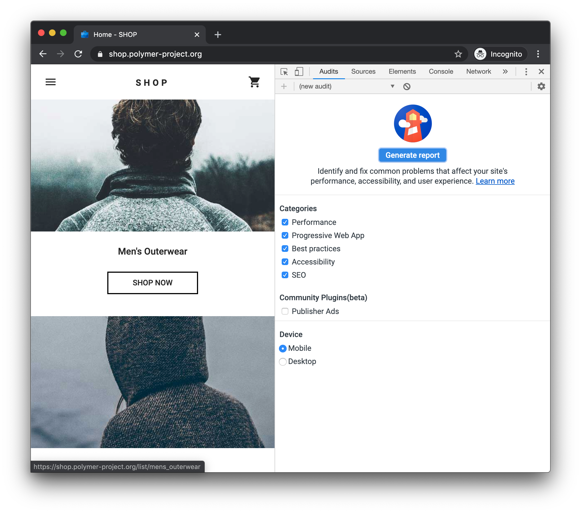
Using Lighthouse to measure performance
https://developers.google.com/web/tools/lighthouse

Slide 24
Using Lighthouse to measure performance
const lighthouse = require('lighthouse');
await lighthouse(url, options, configs);
https://github.com/GoogleChrome/lighthouse/tree/master/lighthouse-core

Slide 25
All code will be available by https://github.com/VicGrygorchyk

Slide 26
Questions? Any? Please...

